Slide 1
Introduction to
ArcGIS automation through scripting with Python

Slide 2
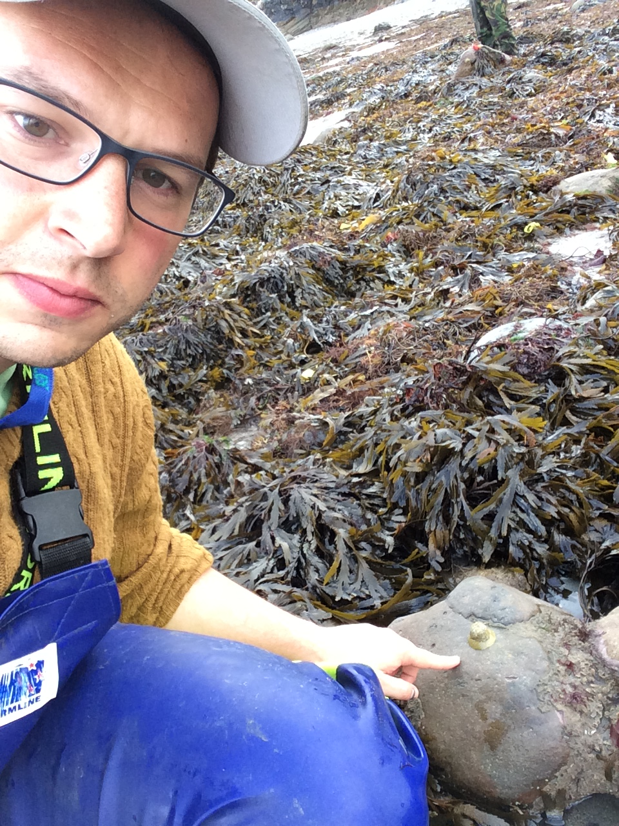
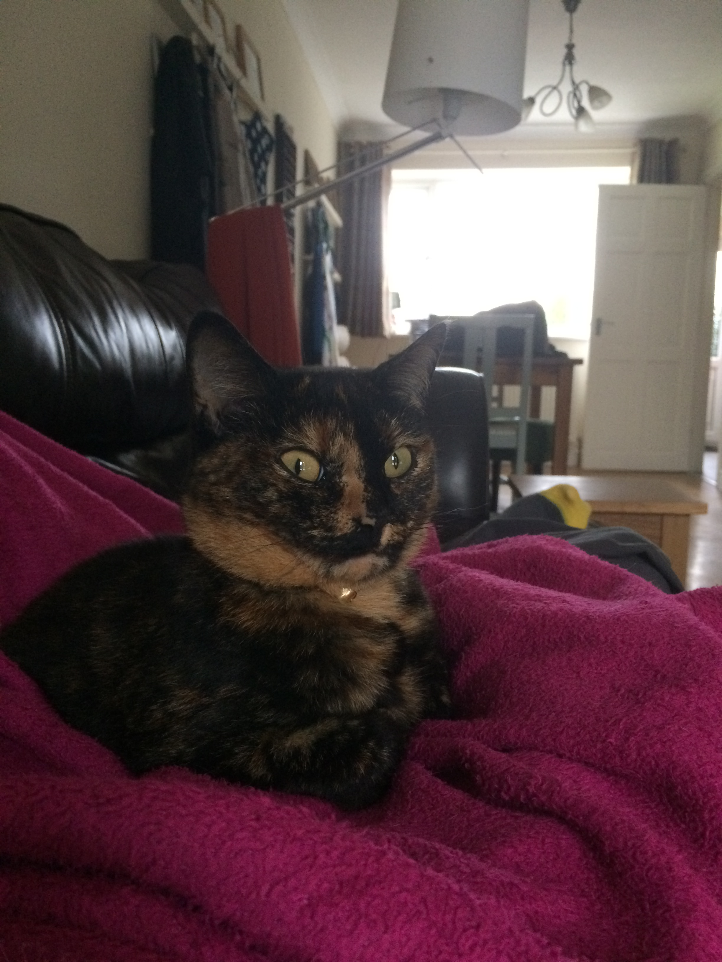
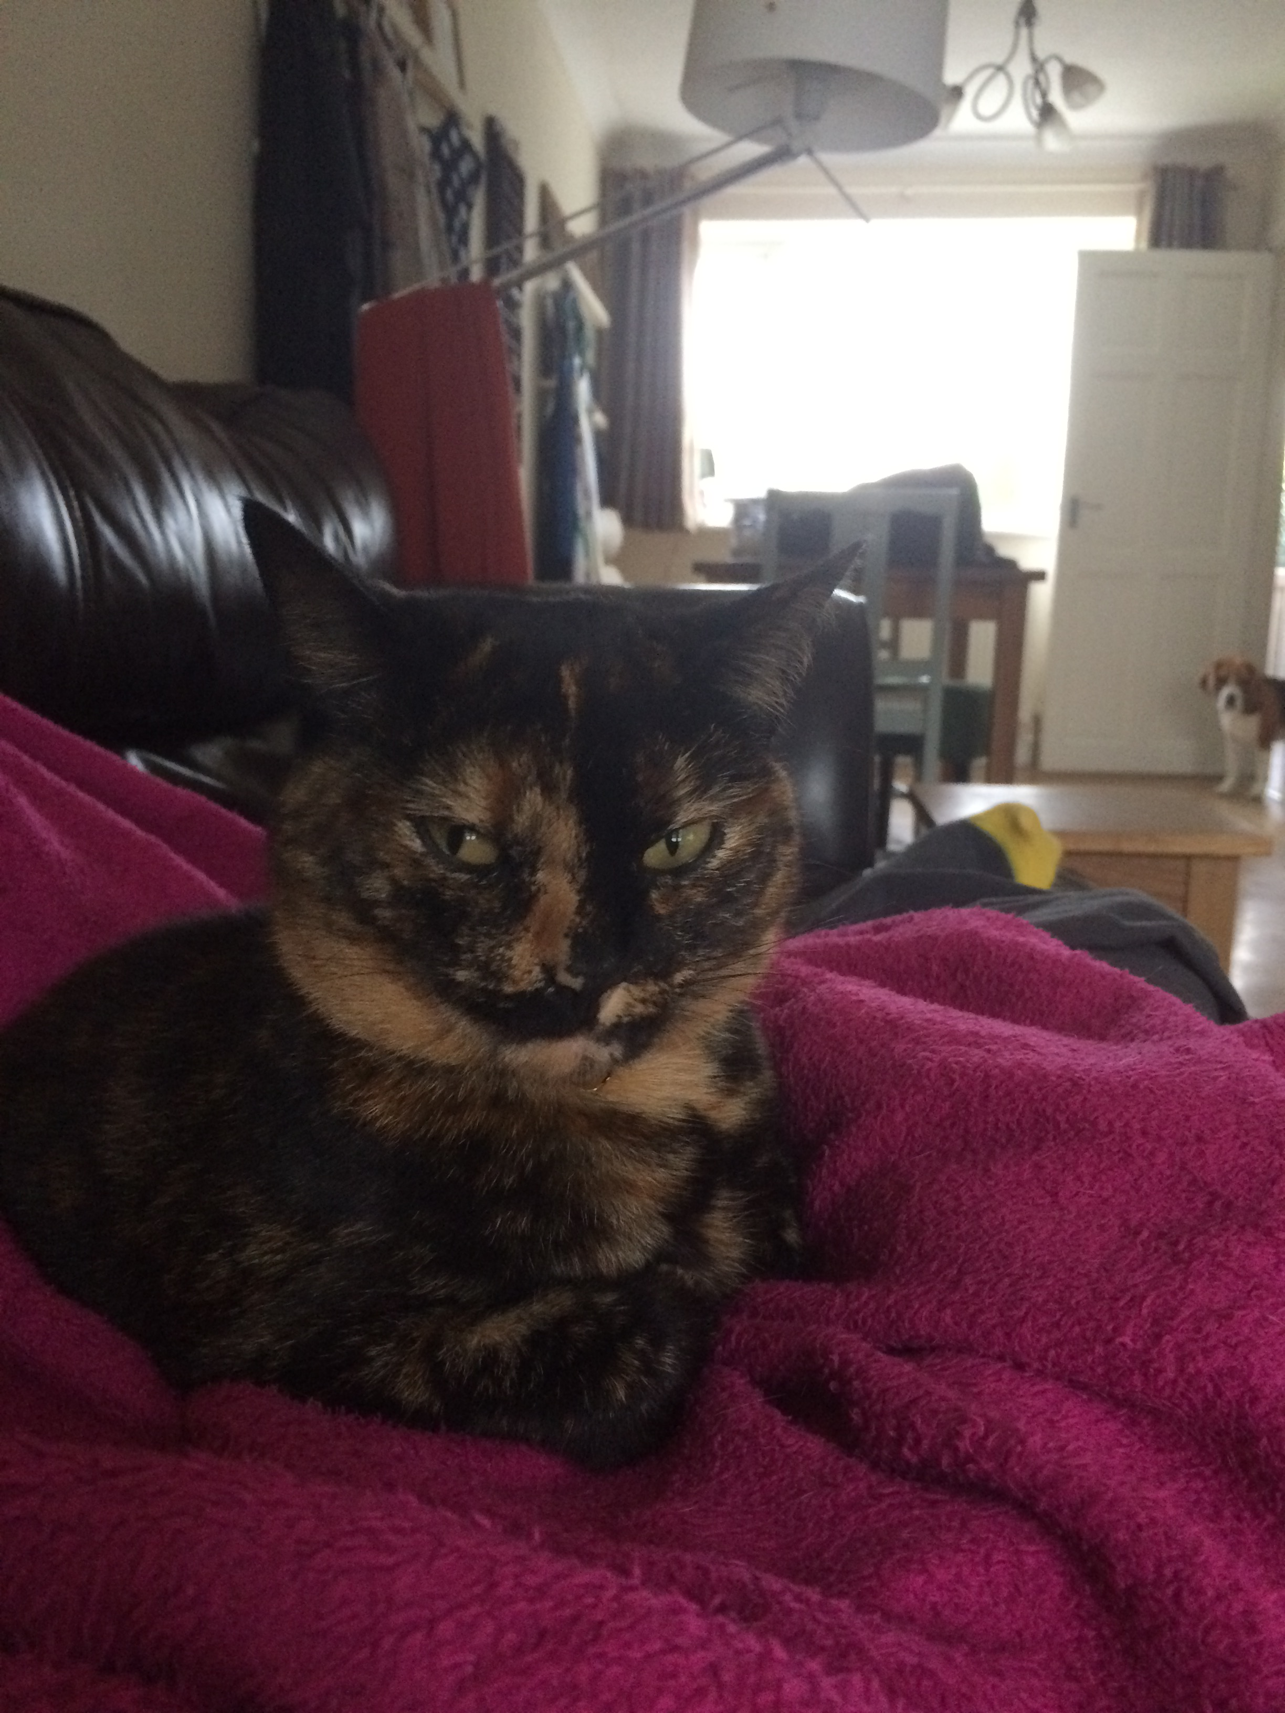
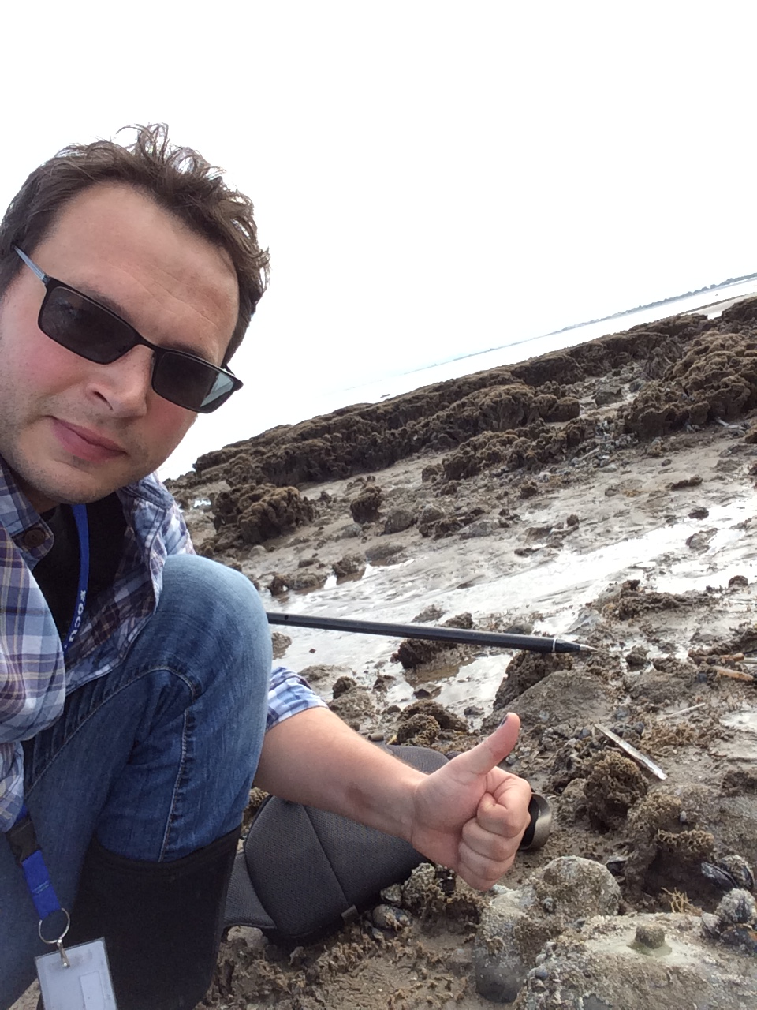

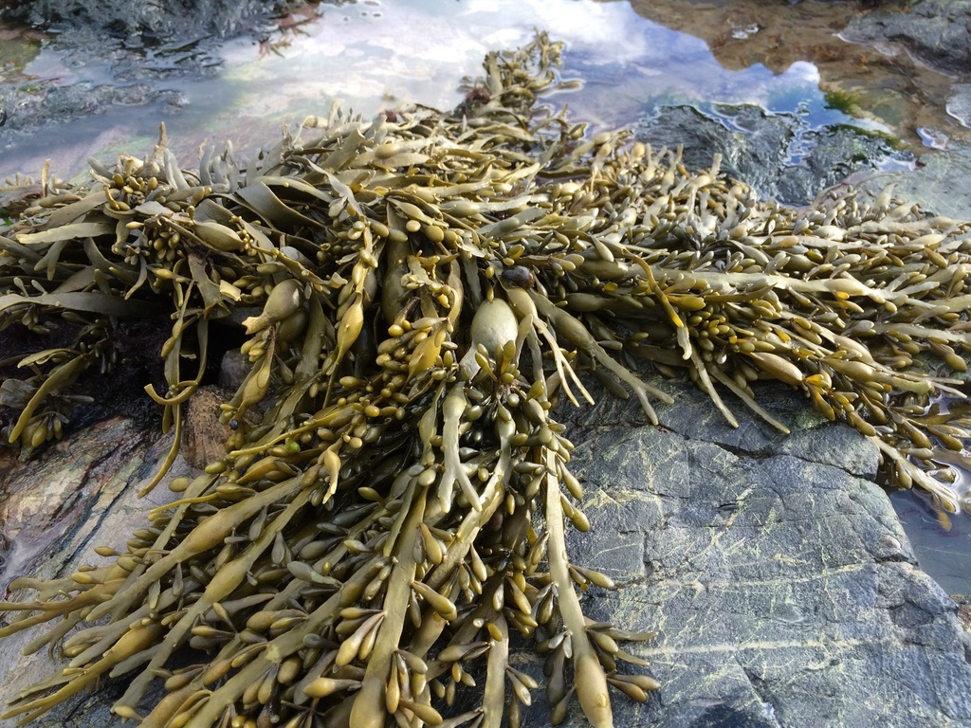
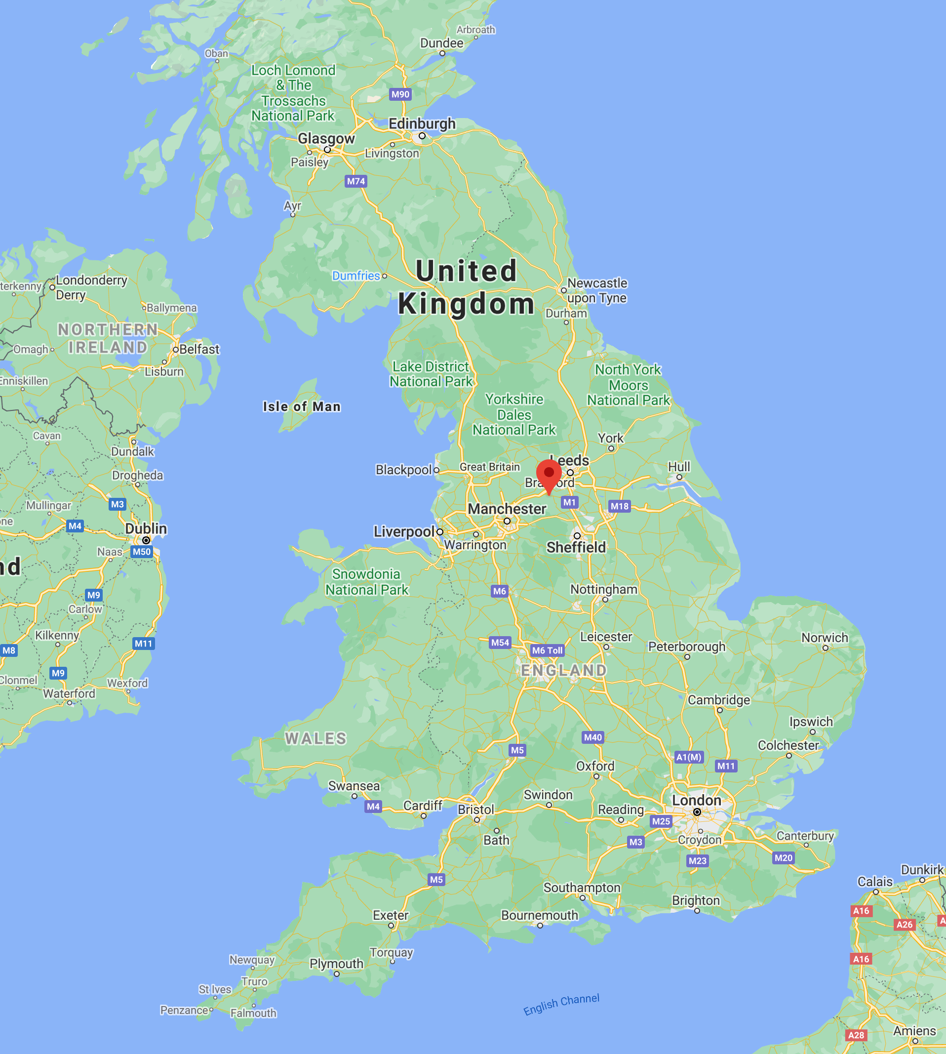

PhD
Cat – Ripley
Dr Andrew J Davies
Rubbish at selfies
Assoc. Professor
Marine ecologist
Specialization in temperate reef formers
CBLS 291 // davies@uri.edu
Post-doc
Faculty
Favorite seaweed
Is a bonafide cyborg
From the UK
World famous

Slide 3
Deaf awareness
I was hearing impaired since birth and during the last 10 years am now profound. This is caused by my nerves in my ear not working correctly.
I have a cochlear implant which gives me an excellent level of hearing (albeit, computer generated), I am a good lip reader too.
Couple of tips:
If you call out, I might not hear (and I have no directionality in hearing), so make sure you attract my attention visually.
Try to speak clearly but don’t feel that you have to change the way you speak, just be normal.
Don’t be afraid to repeat what you said if I miss it or go off on a tangent (I sometimes mishear), sometimes people get embarrassed if having to repeat several times. Don’t worry, eventually I will get it.
Don’t sneak up on a deaf person, always approach from the side so I can see you first before you touch me. Can be very shocking.

Slide 4
Course goals
Expose you to the Python programming language and provide opportunity to practice using basic functionality.
Introduce arcpy and how this can be used to automate and extend geoprocessing tasks.
Provide you with the skills needed to successfully develop Python tools that can be used, not only by yourself, but external users.
Provide practice in the use of Github as supplementary tool for code dissemination and storage.

Slide 5


Slide 6
What is Python and why use it?
Python is an interpreted, object-oriented, high-level programming language with dynamic semantics. Its high-level built in data structures, combined with dynamic typing and dynamic binding, make it very attractive for Rapid Application Development, as well as for use as a scripting or glue language to connect existing components together. Python's simple, easy to learn syntax emphasizes readability and therefore reduces the cost of program maintenance. Python supports modules and packages, which encourages program modularity and code reuse. The Python interpreter and the extensive standard library are available in source or binary form without charge for all major platforms, and can be freely distributed.
Often, programmers fall in love with Python because of the increased productivity it provides. Since there is no compilation step, the edit-test-debug cycle is incredibly fast. Debugging Python programs is easy: a bug or bad input will never cause a segmentation fault. Instead, when the interpreter discovers an error, it raises an exception. When the program doesn't catch the exception, the interpreter prints a stack trace. A source level debugger allows inspection of local and global variables, evaluation of arbitrary expressions, setting breakpoints, stepping through the code a line at a time, and so on. The debugger is written in Python itself, testifying to Python's introspective power. On the other hand, often the quickest way to debug a program is to add a few print statements to the source: the fast edit-test-debug cycle makes this simple approach very effective.
https://www.python.org/doc/essays/blurb/

Slide 7
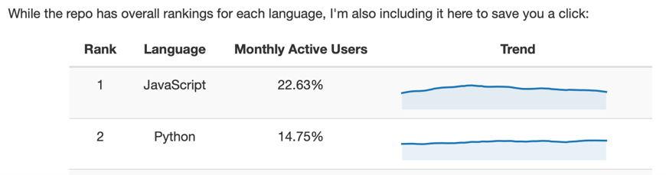
What is Python and why use it?
Just to reiterate:
Easy to read code.
Supports modules and packages (e.g. arcpy).
Free and open source.
Python increases productivity.
Easy edit-test-debug cycle:
Ideal for new programmers and those that are casual code users.
Vastly popular:
#2 On Github for repos.
Lots of code snippets on the internet
https://www.benfrederickson.com/ranking-programming-languages-by-github-users/

Slide 9
What is ArcGIS and why use arcpy?
ArcGIS has been developed over several decades.
Prior to this, we had:
Arc/INFO workstation
ArcView 3.x desktop
Released in 1999, ArcMap 8 was released.
GUI and had some geoprocessing power, but no real environment to work with spatial data in a command line/programming environment.
Strengths are the GUI, Toolboxes, ModelBuilder (introduced in ArcMap 9), standards and extensions (Spatial Analyst, 3D analyst).
Version 10 introduced the arcpy package (can be shown as ArcPy).
Game changer for GIS programmers.
Allows us to interface with other packages.
Rarely need the GUI for any reason but to view/check data.

Slide 10

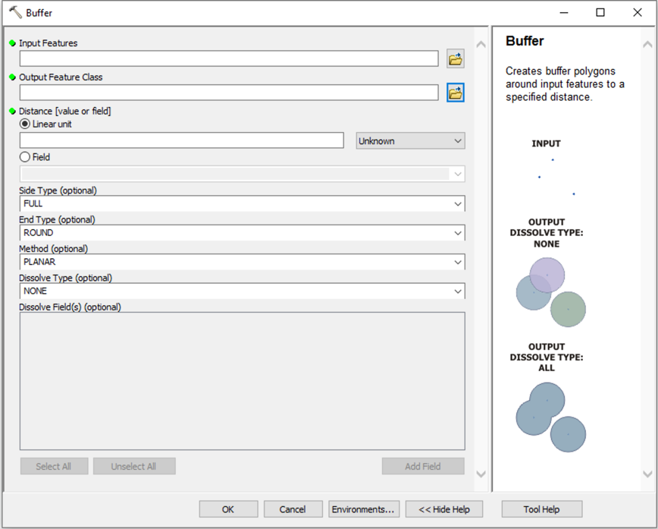
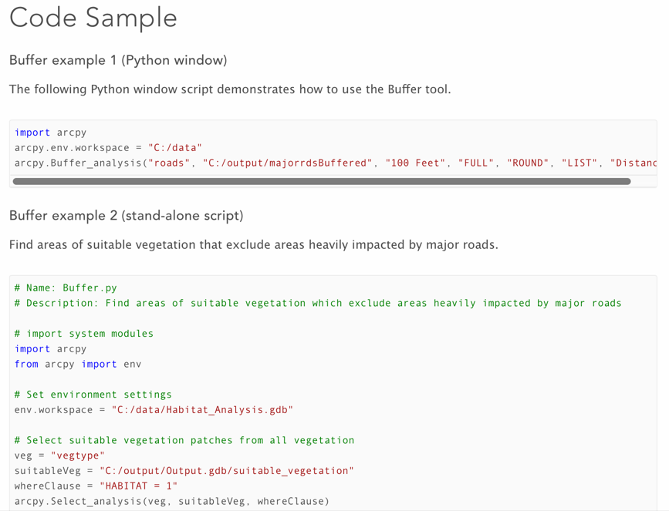
The Buffer Tool in ArcGIS

Slide 11


Slide 12

What is Git and why use Github?
Github is a code hosting website that uses the version control system Git, which was originally created by Linus Torvalds.
Git allows you to create versions, most simply through committing changes to a database.
Allows you to revert back if you make a mess.
Can also be used for collaboration/dissemination of your work.
Has bug/issue tracking and reporting system.

Slide 13
What is Git and why use Github?
Centers around “repositories” aka “repos” which hold your files in a structured manner.
Students (and just announced, now anyone) can have unlimited private (as well as public) repositories.
Private repos are only shared with your collaborators. Useful for crude (and embarrassing code that you don’t want to share).
Public are viewable and interactable by everyone.
It is not just for hosting code, can be for practically anything!
www.github.com

Slide 14
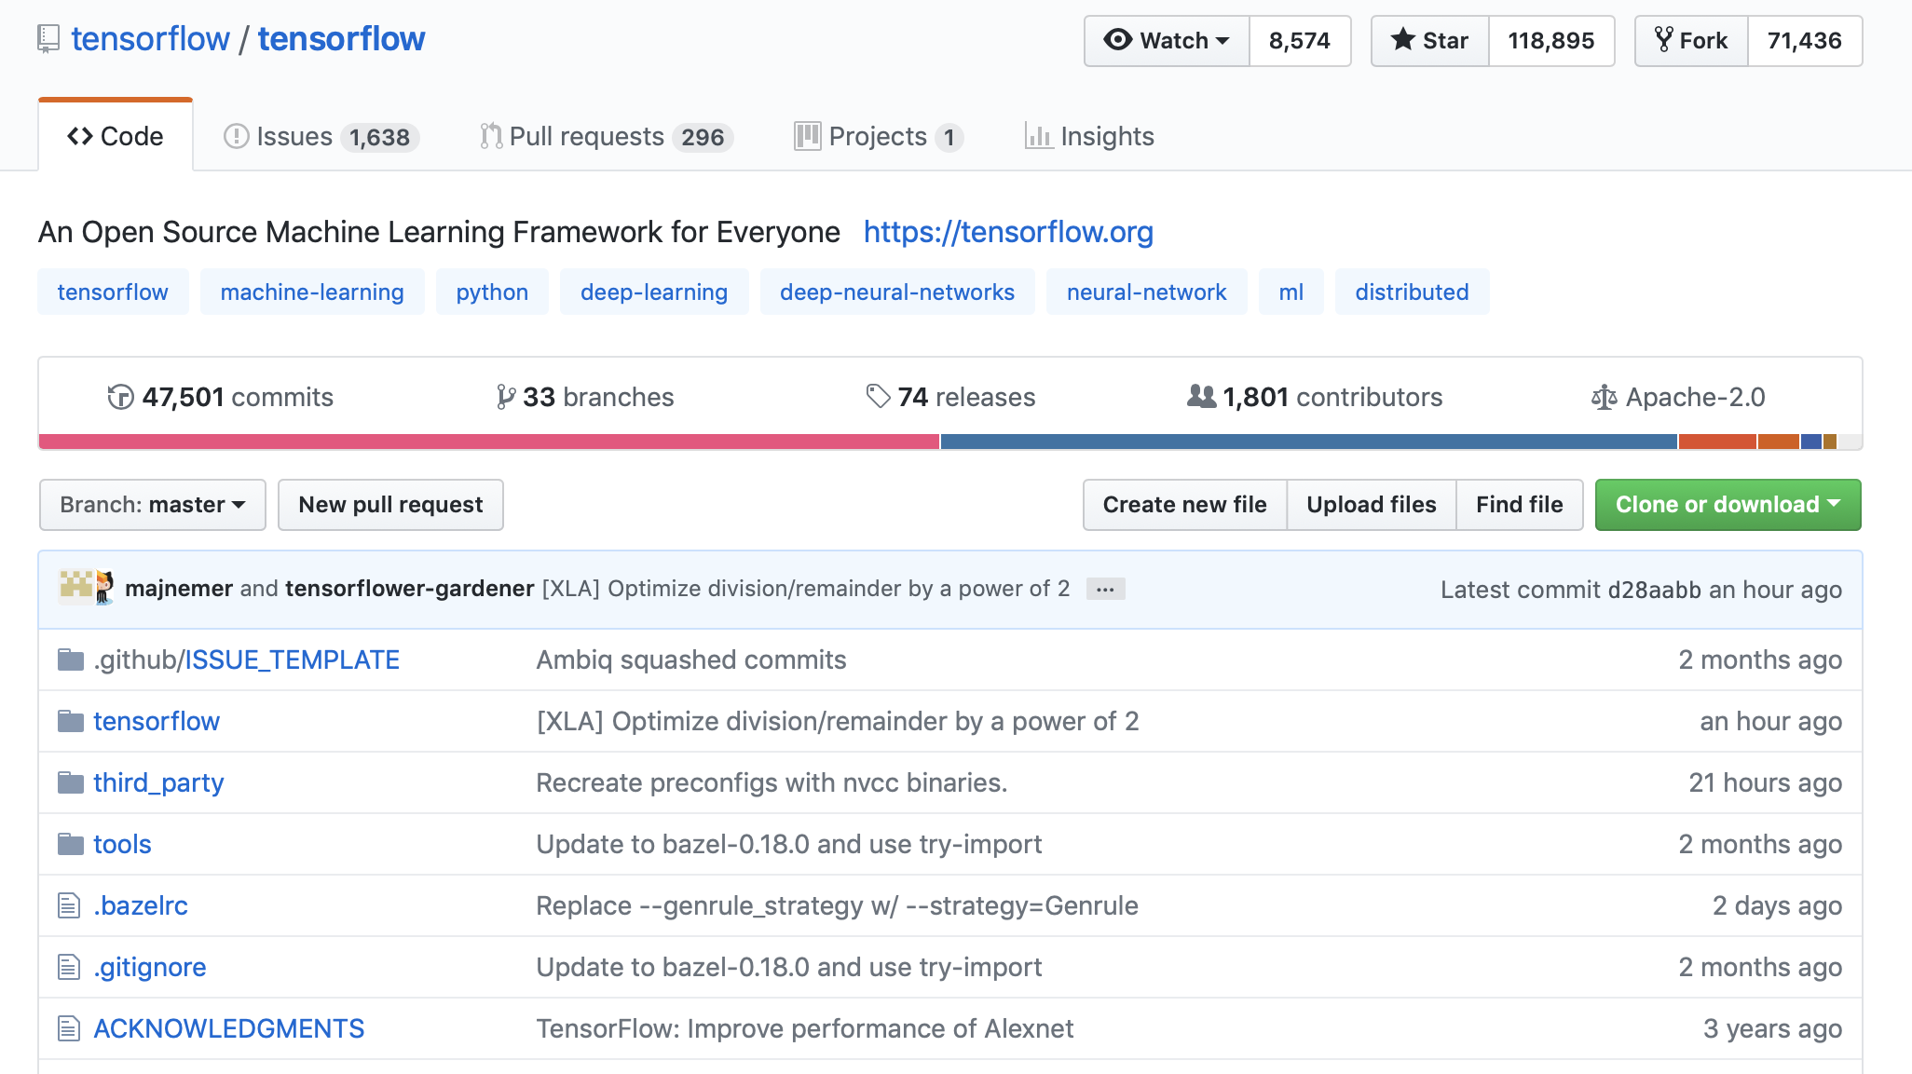
Notes:
1. Account name, plus slash and repository name.
2. Watch = People following bug fixes, commits etc. Star = like/thumbs up, not much tracking. Fork = creates a copy of the current repository that can be edited by yourself.
3. Issues = Reported issues, and bug tracking system. Pull requests = When you make a change, and are not a “committer”, you can suggest code changes that can be merged into a branch. Projects = Kind of a project management system that allows you to set up goals etc.
4. Commits = The changes that you make to the repository, i.e. you make some changes locally and then “commit” the change to the repository.
5. Branches = You may want to create a new branch to test out new features or experiment with a new idea. All without wrecking your main repository.
6. Releases = You can package up a “release” of your code, i.e. as an executable, zip file etc that would “lock” in your code at a certain time. I use releases when I have finished a paper, and use the release as an archive of the code status at the time of publication.
7. Contributors = If you have others working on your code, you may invite contributors.
8. License Type = You can select a license to protect your code if you wish, there are lots of them.
9. Branch selector = You can change branches here.
10. Pull request = You first make a branch, do your changes, and then you can submit a Pull request which will allow other contributors to to discuss the changes and potentially merge the changes into the main branch.
11. Clone or download = Most people will just download your code for review.
12. This is where your files/code are stored.

Slide 15
How will we run the class?
Syllabus and Schedule

Slide 16
Where is the syllabus and course material?
I will regularly commit course materials to the Github Repository:
https://github.com/marecotec/Course_ArcGIS_Python
https://bit.ly/2Mpstgv
As materials will be updated weekly, so you should at least Watch or Star the repo on Github.
Scan if
you can

Slide 17
What will we cover?
!
Developing course, so we may have to change the content as needed. Check Github!
Here
Week 1 | Lecture Introduction, overview of different assignments for this class and modes of teaching. Laboratory Set up Github accounts. The different Python environments and ways to interact with Python through ArcGIS (and not) – Python.exe, bat files, just clicking on a *.py, geoprocessing command line, PyCharm, toolboxes (*.pyt and traditional).
Week 2 | Lecture Introduction to Python basics Laboratory Commenting, import statements for packages, variables and data types (str, int, float, lists, tuples, dictionaries). Iteration using for loops, if/elif/else statements, while statements. Code cleanliness (indentation using tabs/spaces, spotting indentation errors), Using Functions to block code. Zero-based indexing.

Slide 18
Week 3 | Lecture Introduction to Python modules Laboratory os, sys. Basic file and system manipulation. arcpy. Present some arcpy functionality, where can you find scripts, basic resources.
Week 4 | Lecture Building basic scripts Laboratory Cover basic coding tasks, and introduce error handling, print statements and various messaging functionality.
Week 5 | Lecture Building your first script by cheating Laboratory Using ModelBuilder and ArcToolbox to export python scripts. Extending exported python scripts.

Slide 19
Week 6 | Lecture Environments, functions and file handling Laboratory Setting environments within arcpy. How to interact with and code input for tools that are available through arcpy. Avoid repeating code using functions.
Week 7 | Lecture Introduction to Cursors Laboratory Selecting, searching, updating data using arcpy functions, and non-arcpy alternatives.
Week 8 | Spring Break – No Classes
Week 9 | Lecture Geometry objects and raster manipulation Laboratory Creating geometry objects, points, lines and polygons. Creating and working with raster datasets

Slide 20
Week 10 | Lecture Spatial analyst and other extensions in Python Laboratory Practice using various ArcGIS extensions through arcpy. Check out/in licenses, advanced functionality.
Week 11 | Lecture Interacting with ArcGIS Desktop from code Laboratory Techniques to manipulate the desktop environment.
Week 12 | Lecture Effective Python Toolboxes Laboratory Pythonizing your toolboxes to provide usable interactive scripts all within a single python file.

Slide 21
Week 13 | Lecture Designing scripts for others Laboratory Building scripts that can be used by others, open source licenses to protect you and your code and dissemination through Github.
Week 14 | Lecture Code review and end of class discussion
!
I am open to construct sessions based around real-world problems that you are having, so communicate these to me. I would love to be able to tailor the sessions, data examples and code examples to individual and group needs. Especially as much of my data would be marine-based.

Slide 22
Assignments
Assignment | Weighting | Set | Due
Attendance | 10% |  | End of term
Coding challenges | 20% | Each week | Each week
Midterm tool challenge | 25% | Session before Spring Break | Session after Spring Break
Python Toolbox | 25% | Session after Spring Break | End of term
Github account portfolio | 20%
I use a categorical
marking scheme
Column adds up to 100% of your grade

Slide 23
Handing in work
All set dates and deadlines for the various assignments are listed on Brightspace, the hand in time is strictly 23.30 hours on the Friday.
All assignments should be submitted through Brightspace and on your Github repo.
Please see the latter sections of the syllabus for more detail on penalties.
If you are late or have trouble with workload, please reach out! I am here to help and I can work with you to get through this!

Slide 24
Attendance
Attendance is critical to your success in this class. To earn full credit, you must attend and participate in each and every class. If you have an emergency, you are ill, or you have an absence covered under the University policies (i.e. Holy Days, University Sanctioned Events) you are expected to contact the instructor in advance of class. For illness, this particularly pertains to flu-like symptoms, so if you do exhibit signs of flu, contact the instructor and stay home to minimize transference of the virus. Unexcused absences will result in a lower course grade.

Slide 25

Coding challenges
!
You should commit your code to your Github account as part of your Github Portfolio.
Learning to code is not something that can be done entirely within a classroom, as it requires much practice and reinforcement, which can only be achieved individually.
Prior to each class you will undertake a self-study “Coding challenge”, which will take approximately two to three hours of your time.
The first 10 minutes of each class is reserved for the coding challenge quiz, whereby you will answer specific questions pertaining to your code, the methods used and the produced output.
Start here

Slide 26
Midterm tool challenge
In this assignment, you are instructed to produce a small tool that takes advantage of arcpy and Python.
You will need to provide example data, and the code should run on all PC’s.
The tool needs to manipulate a dataset across three different processes, for example, extracting, modifying and exporting data. The exact workflow is entirely up to yourself.
You are expected to take 3-4 hours on this coding assignment, and you should deposit your code and example files within a Github repository for feedback and grading.
Criteria are, 1) cleanliness of code, 2) functionality, appropriate use of documentation and depth of processing operation.

Slide 27
Python toolbox
In your final assignment for this course, you should create a Python Toolbox that contains a minimum of three simple tools for undertaking geoprocessing and file management operations.
These tools can be discrete or part of a larger workflow. However, the caveats are that you should create a "single file" toolbox (no includes, or external file tools) and not exceed 2000 lines of code in its entirety.
You should document the toolbox using Github README.md and provide example data for running each of your tools.
Grading and feedback will focus on: 1) Does the toolbox install, and the tools run successfully? 2) cleanliness of code, 3) functionality and depth of processing operation, and 4) appropriate use of documentation.

Slide 28
Github portfolio
The final assessment component is your Github coding portfolio. As a coder, your Github account can also act as an unofficial resume, providing potential employers, graduate supervisors or collaborators with ready access to your prior work.
You must maintain a high quality Github account for the other assignments set, this includes providing adequate and well-organized readme files, well commented code and a coherent file structure.
Grading and feedback will focus on 1) High level of organization and 2) Descriptive readme files and well commented code.

Slide 29
How I layout materials
We will work through each lecture together, using coding worksheets that I have developed for each class, which are available on Github.
We will move as slow or as fast as we need to, and I am available after class on Fridays to work through issues that individuals are having.
If needed, I will work with you individually to overcome any issues.

Slide 30
Office hours and my teaching ethos
If you need me, and my office door is open (CBLS 291), just knock and call in, any time.
My official office hours are Tues/Thurs at 1500-1700.
Normally it is easy to just drop me an email and arrange a time, so feel free to do that if you need help.
You can email me, and expect a prompt response during normal working hours 9-6 M-F.
I am here to help you learn, to push and guide you, but at the end of the day, the motivation must come from you. If you don’t engage with class and don’t communicate with me, then I can’t help you.

Slide 31
Where is the syllabus and course material?
I will regularly commit course materials to the Github Repository:
https://github.com/marecotec/Course_ArcGIS_Python
https://bit.ly/2Mpstgv
As this is a developing course, revised materials will be added weekly, so you should at least Watch or Star the repo on Github.
Scan if
you can

Slide 32
Any questions/suggestions before we move on?
?

